Slide 1

AIDS
Title of the Project: Stock Market Prediction
Group Members:
1.Atharva Shinde -54
2.Neeraj Rijhwani -64
3.Himanshu Naik -63
Professor Name:Dr.Ravita Mishra

Slide 2

Content
Overview
Introduction
Problem Statement
Objectives
Proposed System
Proposed Design
Conclusion

Slide 3
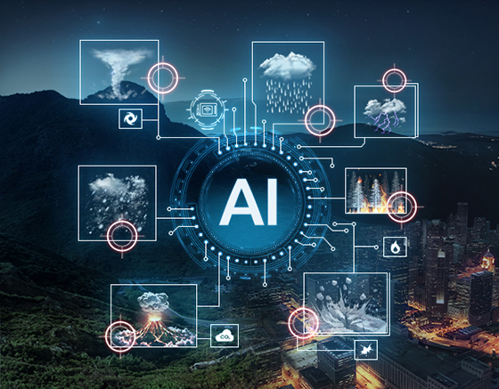
Introduction
r Rates
Stock market prediction involves analyzing historical data, trends, and financial indicators to forecast future stock prices and market behavior. Artificial Intelligence enhances prediction accuracy by identifying complex patterns in vast datasets using machine learning algorithms. These models learn from past market fluctuations to anticipate future movements. Real-time data from financial feeds, news, and sentiment analysis further improves forecasting. Accurate stock predictions aid investors in making informed decisions, optimizing portfolios, and minimizing financial risks in dynamic market environments.

Slide 4
Problem Statement
Stock market fluctuations are influenced by a complex interplay of economic, political, and social factors, making accurate prediction a significant challenge. Traditional forecasting methods often fall short in capturing sudden market shifts and complex patterns, leading to suboptimal investment decisions and financial losses. Investors and institutions struggle with limited analytical tools, delayed insights, and overwhelming volumes of data. AI-driven stock market prediction offers the potential to enhance forecasting accuracy by leveraging real-time data, historical trends, and machine learning algorithms. However, challenges such as data quality, market volatility, and model interpretability must be addressed for reliable and effective implementation.

Slide 5
Existing Solution
Key Features:
Use of historical stock price data and financial indicators for trend analysis.
Application of technical analysis and statistical models for market forecasting.
Machine Learning algorithms for pattern recognition and future price prediction.
Real-time data feeds from financial markets for dynamic decision-making.
Limitations:
Difficulty in capturing unpredictable events (e.g., geopolitical issues, natural disasters).
High market volatility reduces model reliability and consistency.
Limited availability of high-quality, labeled data for certain stocks or markets.
Overfitting and bias in AI models due to noisy or redundant data.
Challenges in interpreting complex AI models for transparent decision-making.

Slide 6
Solution
The proposed AI-driven stock market prediction system aims to enhance investment decision-making by integrating real-time financial data, machine learning models, and cloud-based analytics. The system will use decision trees and deep learning techniques to analyze historical stock trends and real-time market indicators, enabling accurate short-term (7-day) and mid-term (1-month) stock price forecasts. By leveraging financial news sentiment, technical indicators, and AI-based models, the system will help traders, investors, and analysts make informed decisions and reduce financial risk.
Key Features:
AI-powered predictive models for short and medium-term stock price forecasting.
Integration of real-time market data, financial indicators, and sentiment analysis.
Automated alerts and reports to assist in timely investment decisions.

Slide 7
Stock Market Prediction System Architecture
🔹 Data Collection Layer Gathers real-time and historical stock data from financial markets, APIs (e.g., Yahoo Finance, Alpha Vantage), news sources, and social media sentiment analysis tools.
🔹 Data Processing Module Cleans, normalizes, and preprocesses raw data by handling missing values, removing outliers, and generating technical indicators for better model input.
🔹 AI & Machine Learning Models Applies decision trees, random forests, and deep learning algorithms (e.g., LSTM, GRU) to detect patterns, trends, and forecast stock prices for 7-day and 1-month intervals.
🔹 Cloud-based Analytics Platform Leverages scalable cloud infrastructure (e.g., Google Colab, AWS, Azure) for training, validating, and deploying prediction models in real-time.

Slide 8
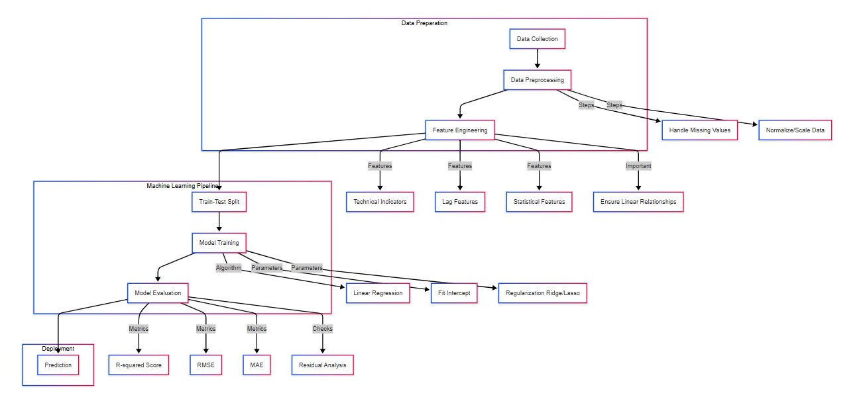
Proposed Design

Slide 9
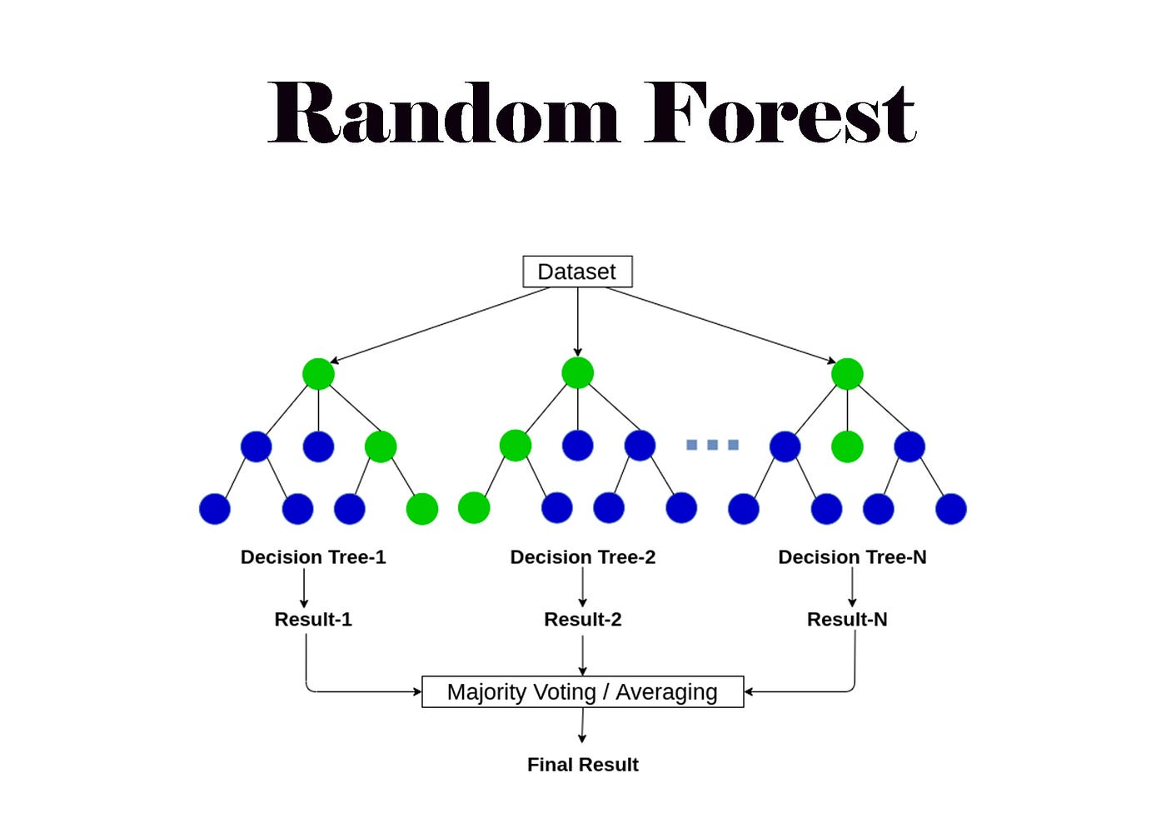
Algorithm Used
1. Linear Regression: Used for predicting stock prices based on historical data, identifying trends and potential future price movements.
2. Decision Tree: A machine learning algorithm that analyzes various market factors and historical stock performance to make predictions about future stock trends. link
3. Random Forest: An ensemble learning method that combines multiple decision trees to improve accuracy in predicting stock market fluctuations by analyzing different financial indicators and trends. link
4. K-Means Clustering: Helps in grouping stocks into clusters based on similar performance patterns, assisting in identifying high-performing stocks or sectors based on historical trends.
Notes:
The max flow algorithm in the visualization is :-

Slide 10
Conclusion
The integration of AI into stock market prediction significantly enhances forecasting accuracy, enabling better investment decisions and reducing financial risks. By leveraging machine learning, deep learning, and real-time market data analysis, the proposed system offers an innovative approach to stock market forecasting. AI-driven predictive models help investors identify trends, optimize portfolios, and make timely decisions, minimizing losses and maximizing returns. While challenges such as data quality, model accuracy, and market volatility remain, ongoing advancements in AI technology will further improve stock market prediction systems, ultimately contributing to more informed financial strategies and a more stable investment environment.

Slide 11
Refrences
[1]
Emin Cilingiroglu, “Artificial Intelligence in the Stock Market: Quantitative Technical Analysis, Model Weight Optimization, and Financial Sentiment Evaluation to Predict Stock Prices,” Intersect: The Stanford Journal of Science, Technology, and Society, vol. 17, no. 1, 2023, Accessed: Apr. 14, 2025. [Online]. Available: https://ojs.stanford.edu/ojs/index.php/intersect/article/view/3031?utm_source=chatgpt.com
‌
[1]
D. Muhammad, I. Ahmed, K. Naveed, and M. Bendechache, “An explainable deep learning approach for stock market trend prediction,” Heliyon, vol. 10, no. 21, pp. e40095–e40095, Nov. 2024, doi: https://doi.org/10.1016/j.heliyon.2024.e40095 .

